Slide 1


CSE 470/598 Transformations2
Ross Maciejewski
rmacieje@asu.edu

Slide 2
Refresher
Write out the basic forms for a 2D:
Scaling matrix
Rotation matrix
Translation matrix
Why is Translation transform affine but not linear?
What are homogeneous coordinates?
What is the basic form of a 3D point in homogeneous coordinates?
What about a 3D vector?

Slide 3
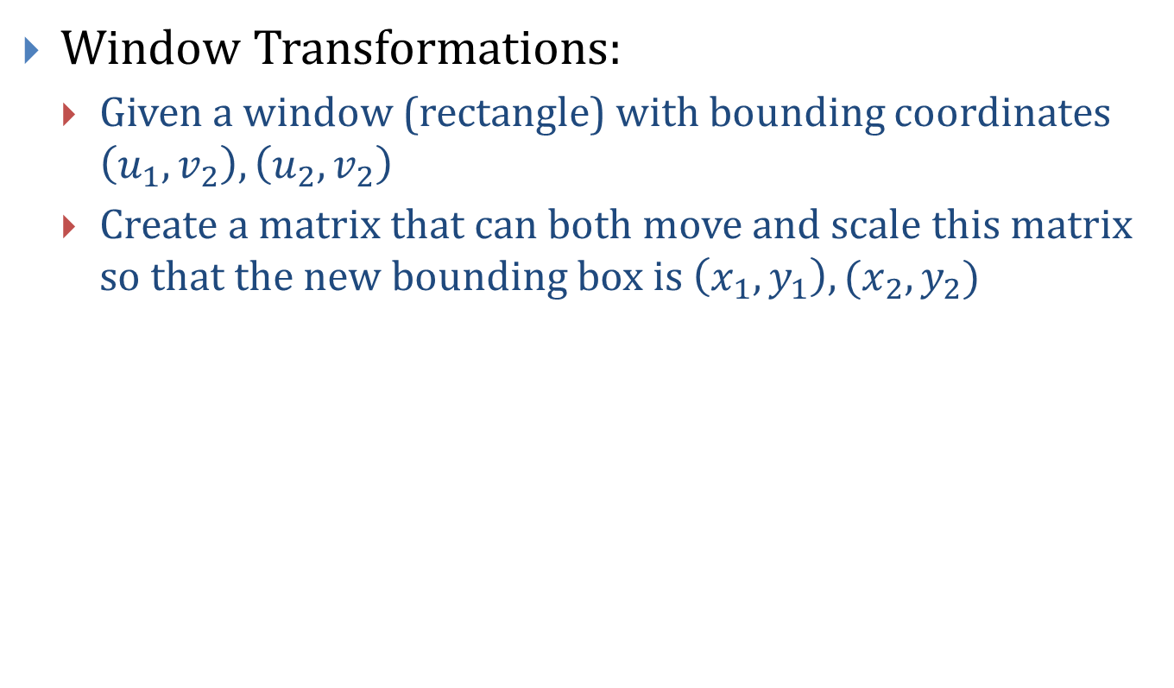
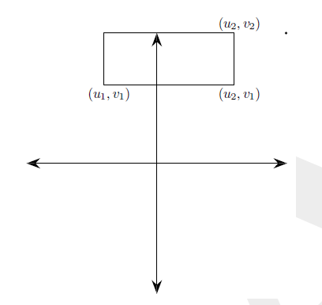
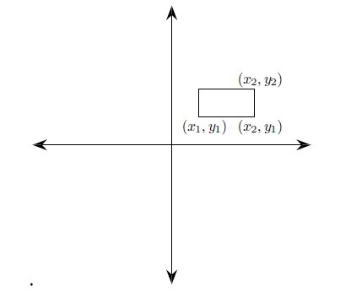
Exercise

Slide 4
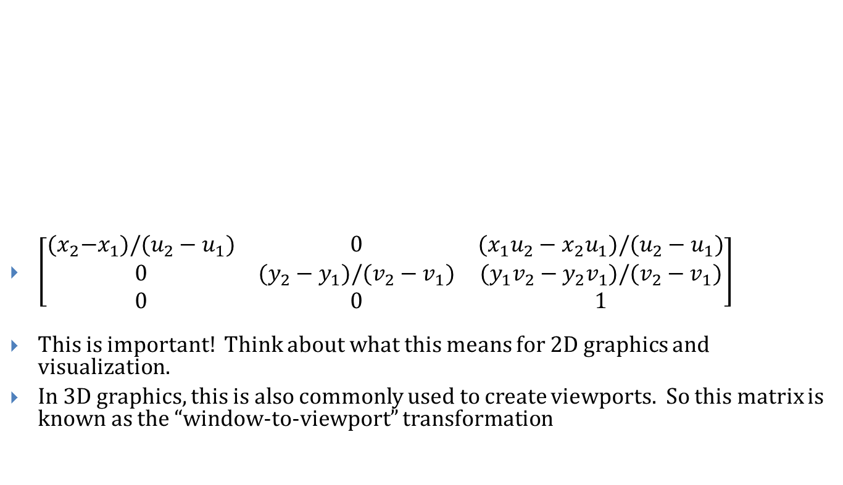
Exercise - Solution

Slide 5
Questions?

Slide 6
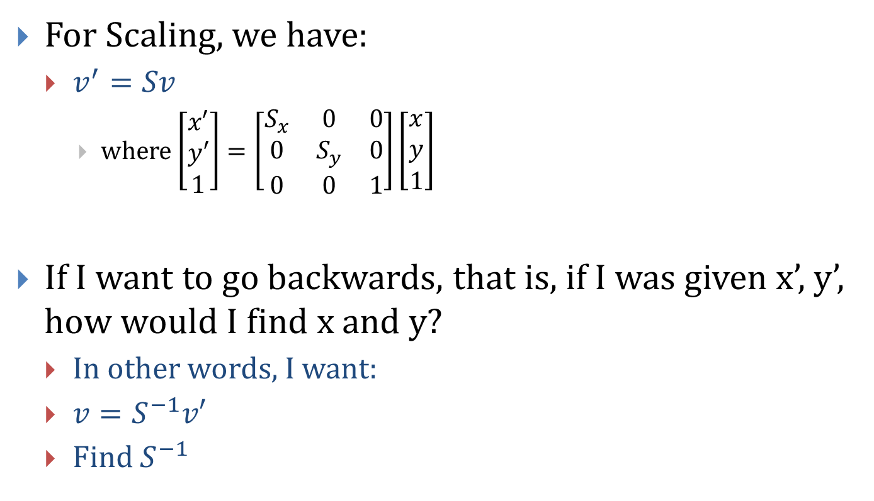
Matrix Inverse

Slide 7
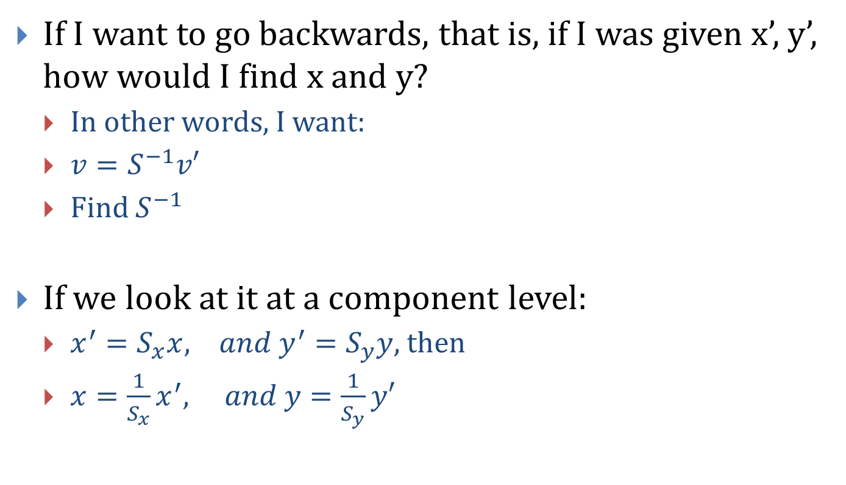
Matrix Inverse

Slide 8
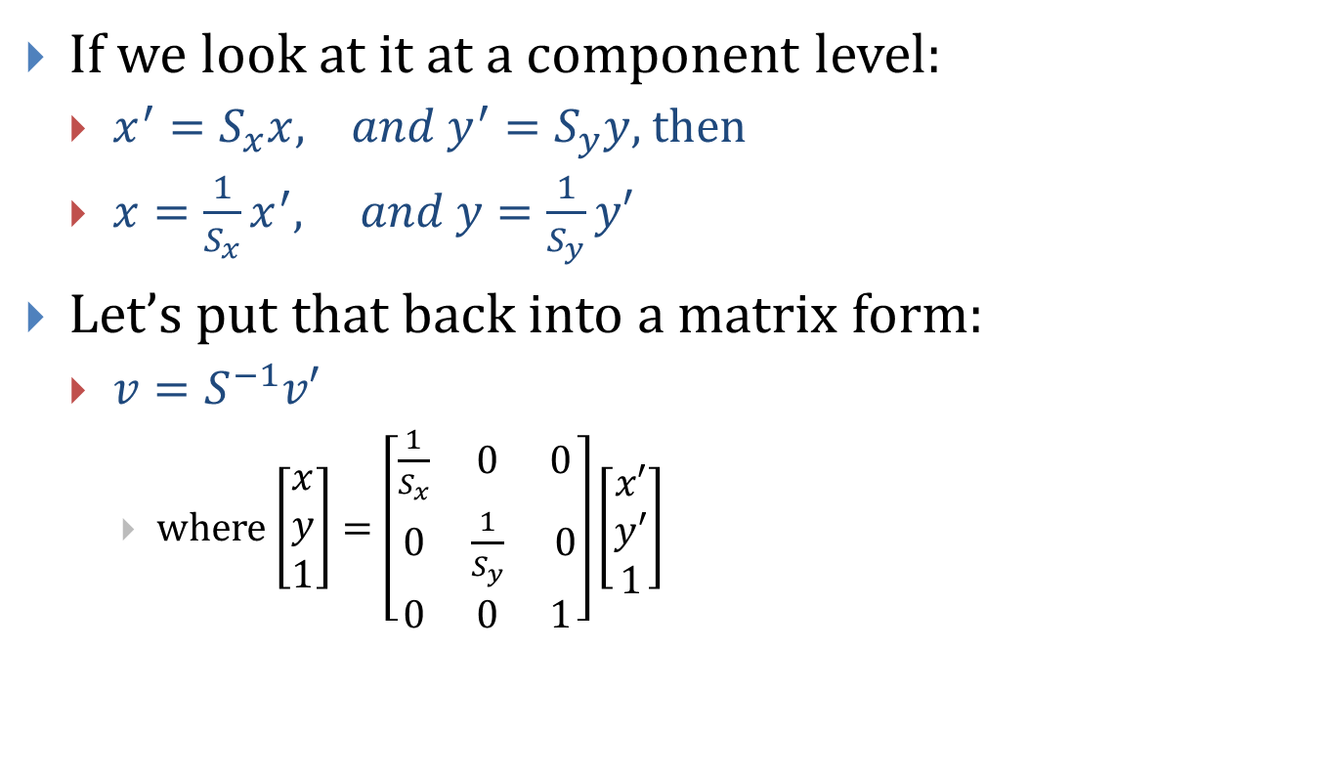
Matrix Inverse

Slide 9
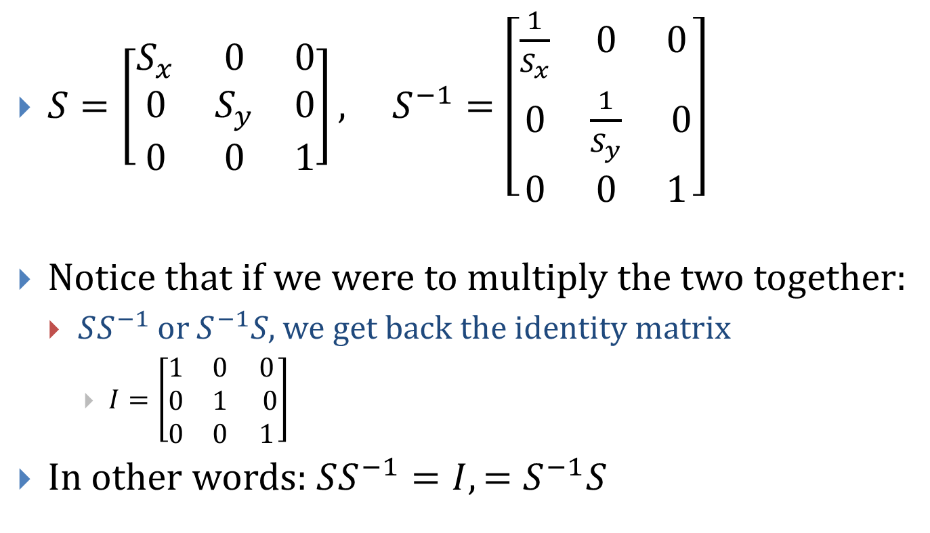
Matrix Inverse

Slide 10
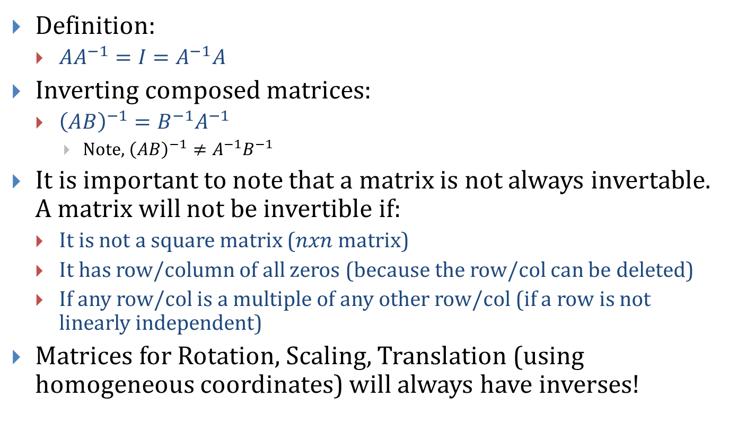
Matrix Inverse

Slide 11
One Way To Think About Inverses…
Is to think of an inverse as an “undo”
For example, if A scales by a factor of 2 and rotates 135 degrees, then A⁻¹ will rotate by -135 degrees and scale by 0.5
Rectangle(B)
A*B
A⁻¹*B
A⁻¹*A*B

Slide 12
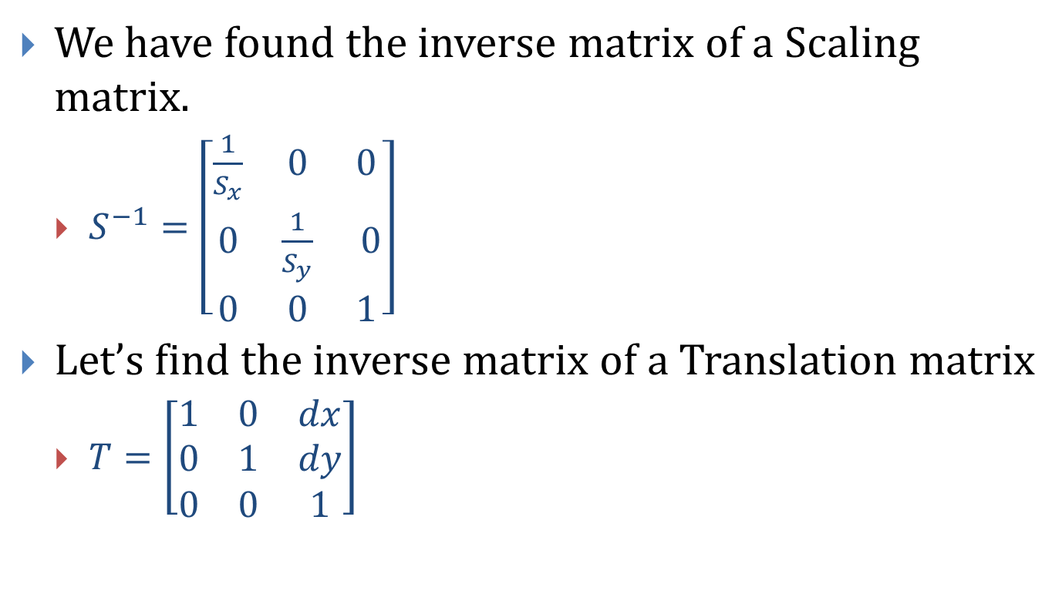
Finding Inverse Matrices…

Slide 13
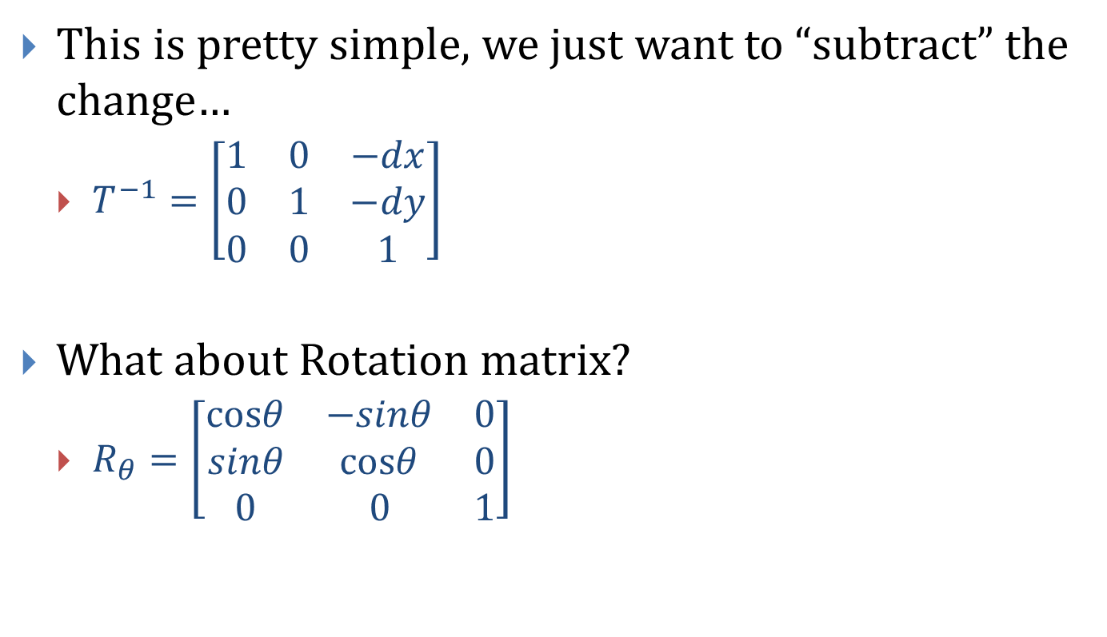
Finding Inverse Matrices…

Slide 14
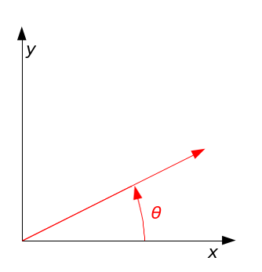
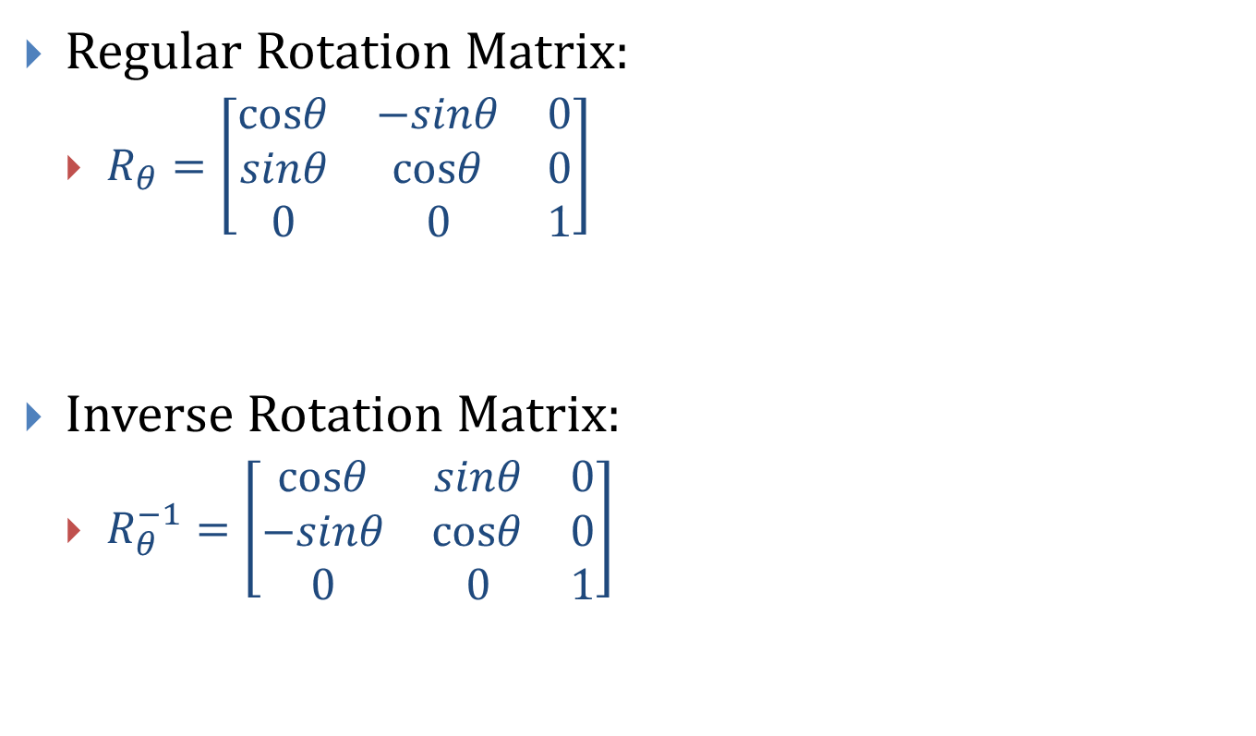
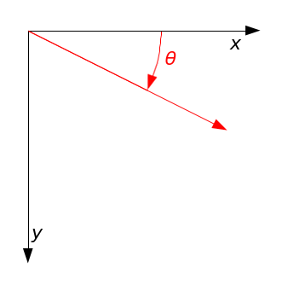
Inverse Rotation Matrix

Slide 15
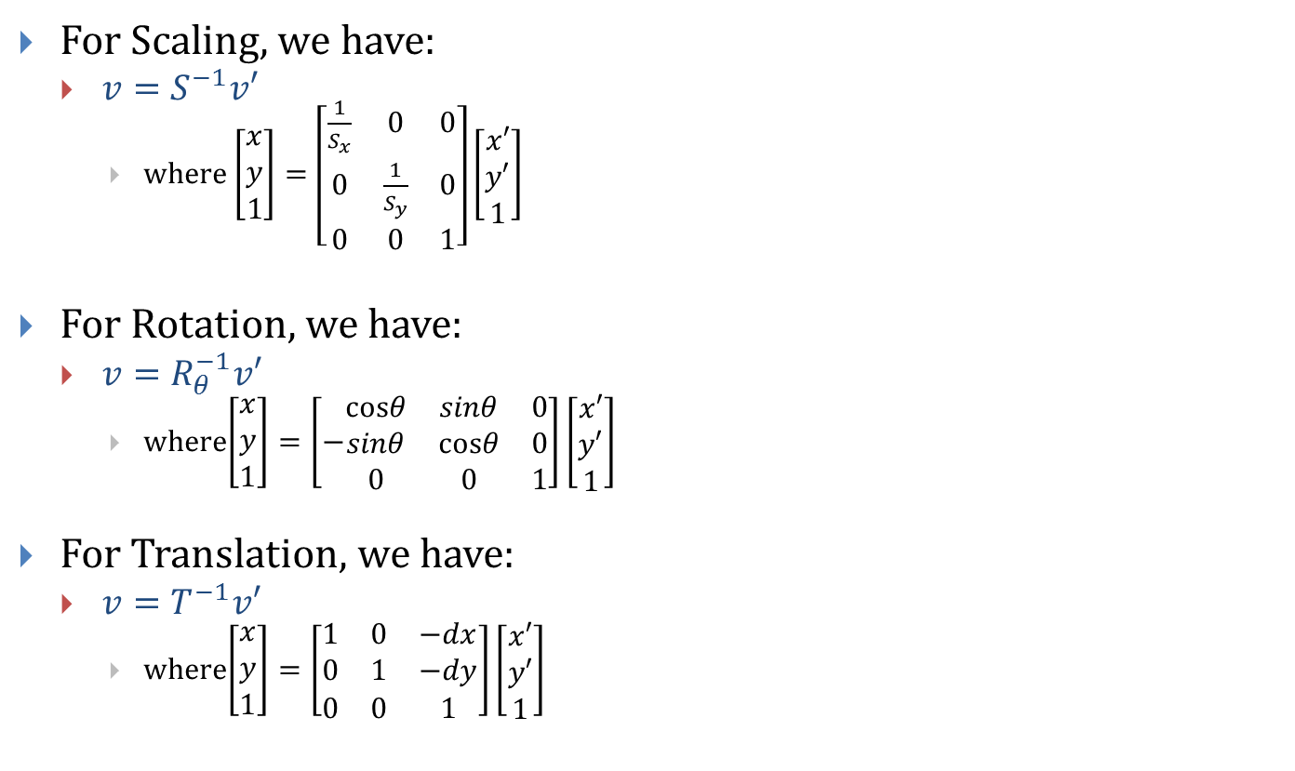
Recap of Inverses

Slide 16
Questions?

Slide 17
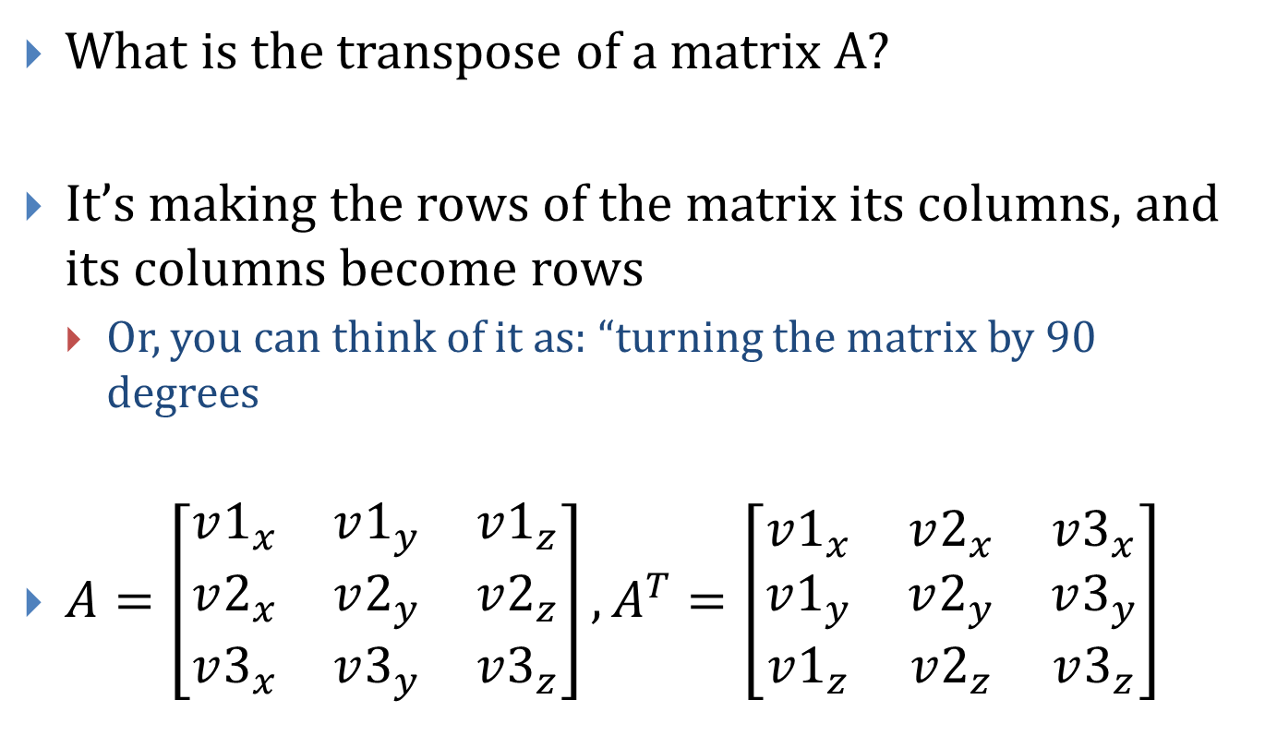
Matrix Transpose

Slide 18
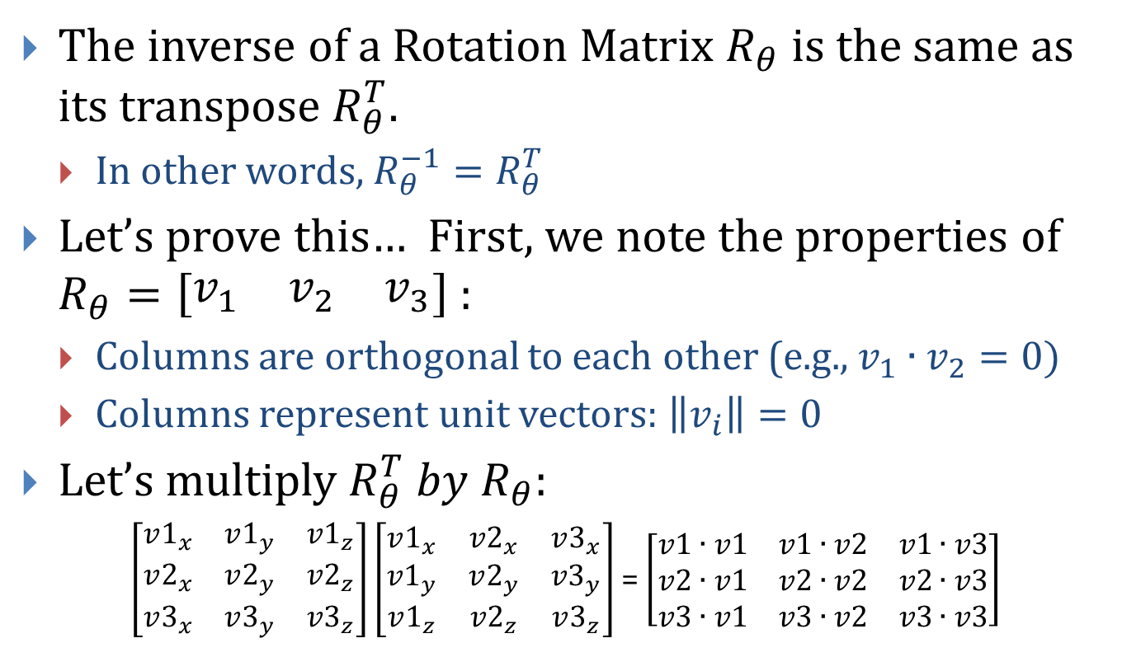
Neat Fact about Rotation Matrix

Slide 19
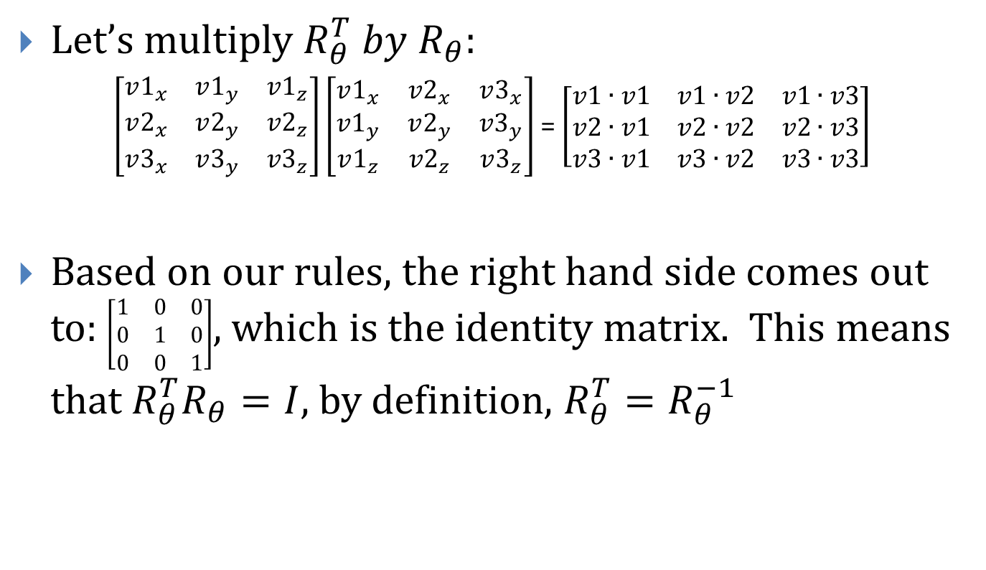
Neat Fact about Rotation Matrix

Slide 20
Questions?

Slide 21
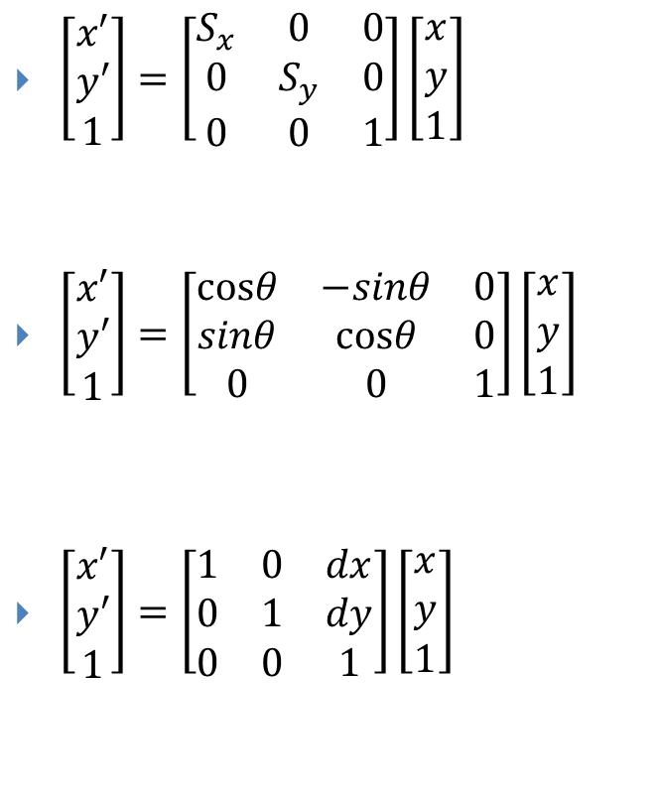
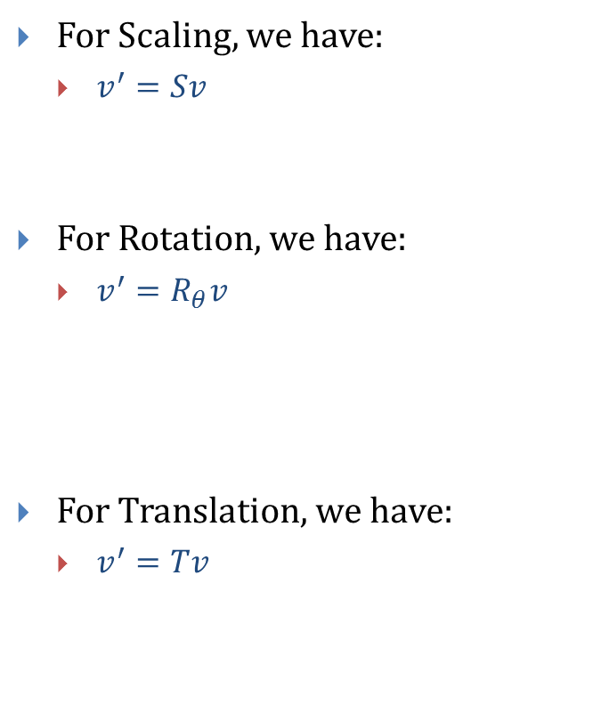
Composition of Transformations!

Slide 22
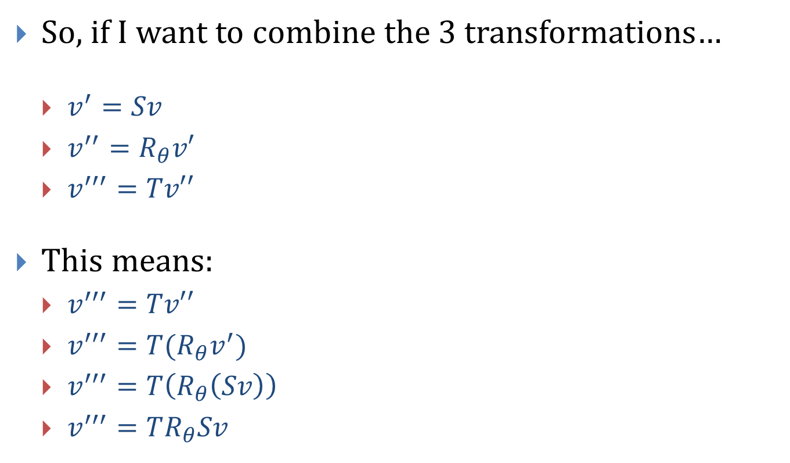
Composition of Transformations!

Slide 23
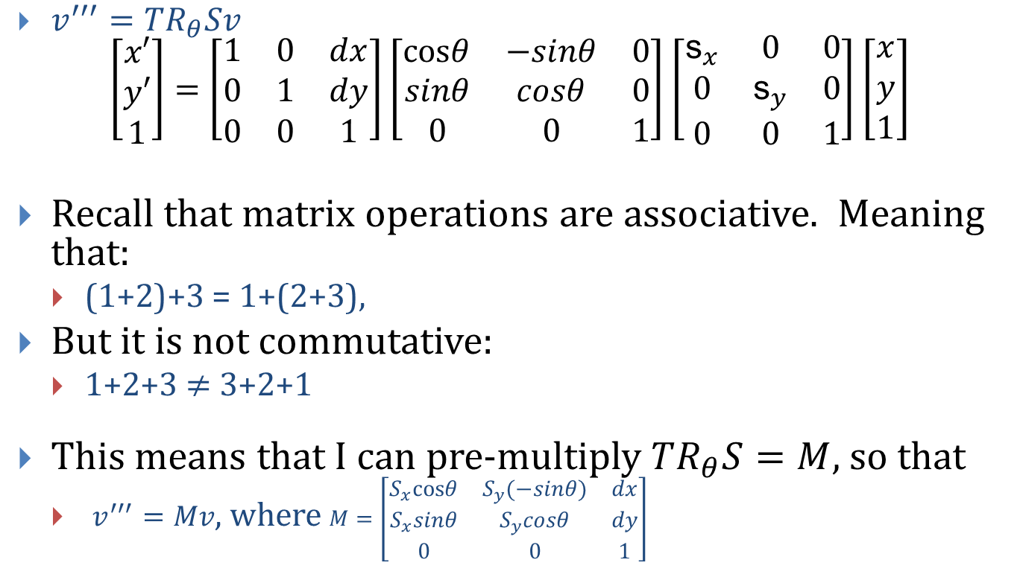
Composition of Transformations!

Slide 24
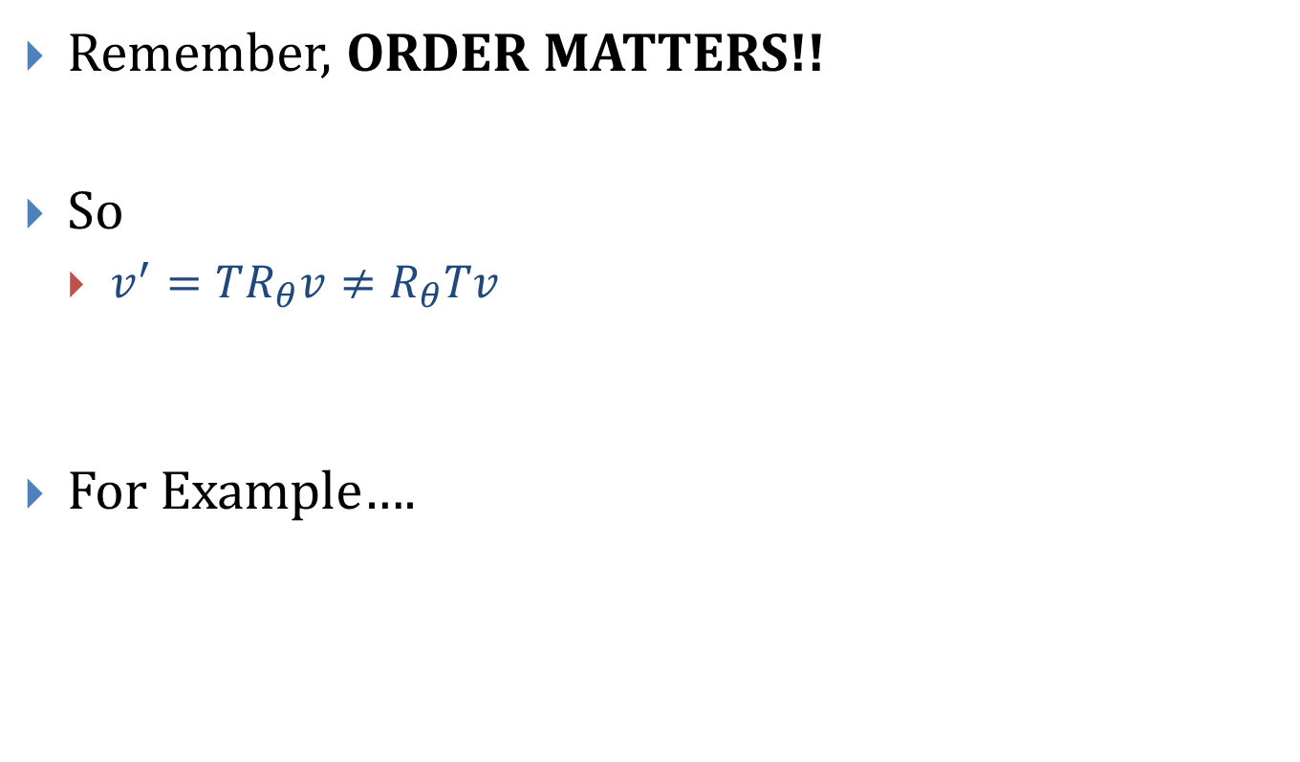
Composition of Transformations!

Slide 25
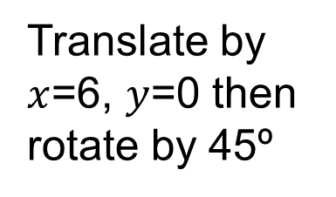
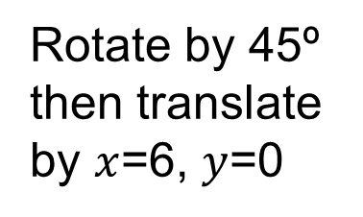
Not commutative
6
5
4
3
2
1
0
1
2
3
4
5
6
7
8
9
10
Y
6
5
4
3
2
1
0
1
2
3
4
5
6
7
8
9
10
X

Slide 26
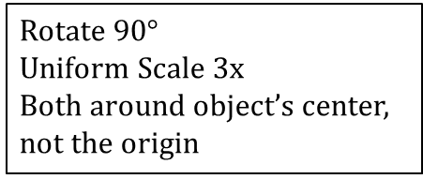
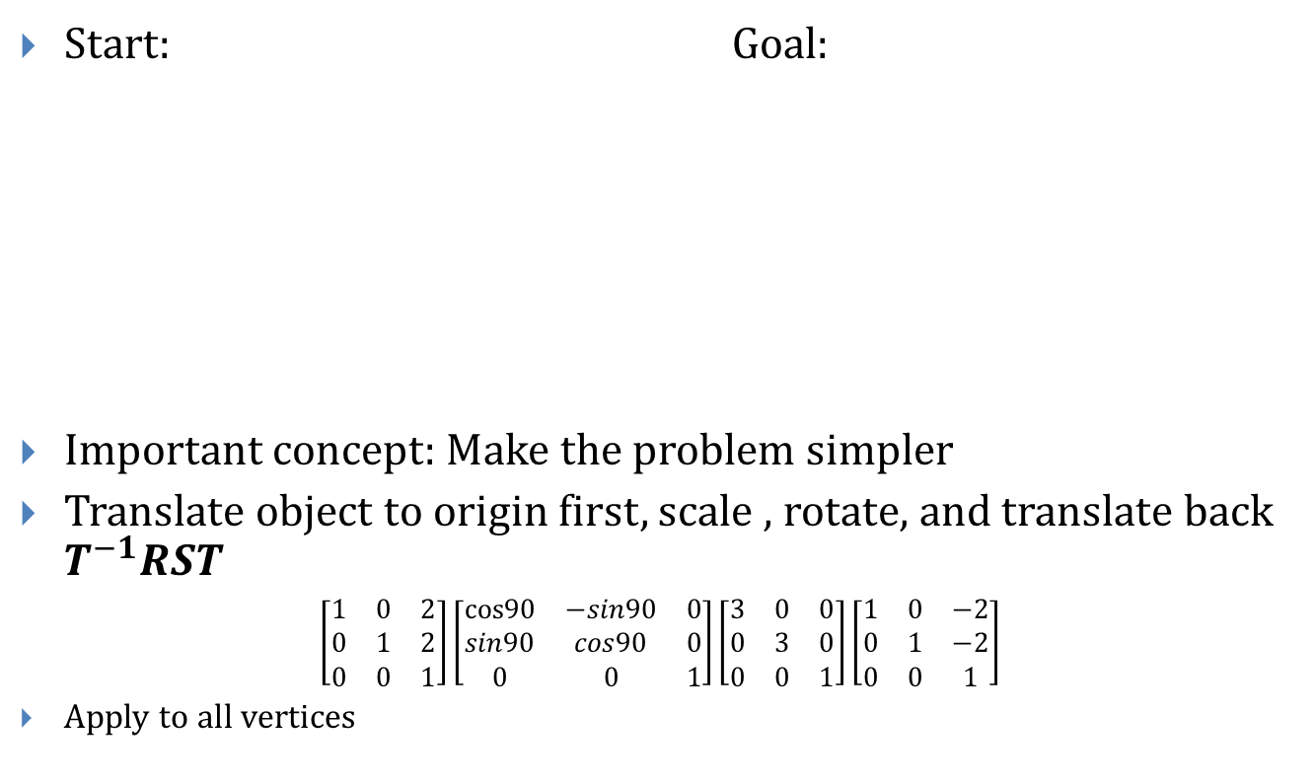
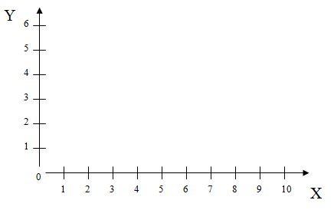
Composition (an example) (2D)

Slide 27
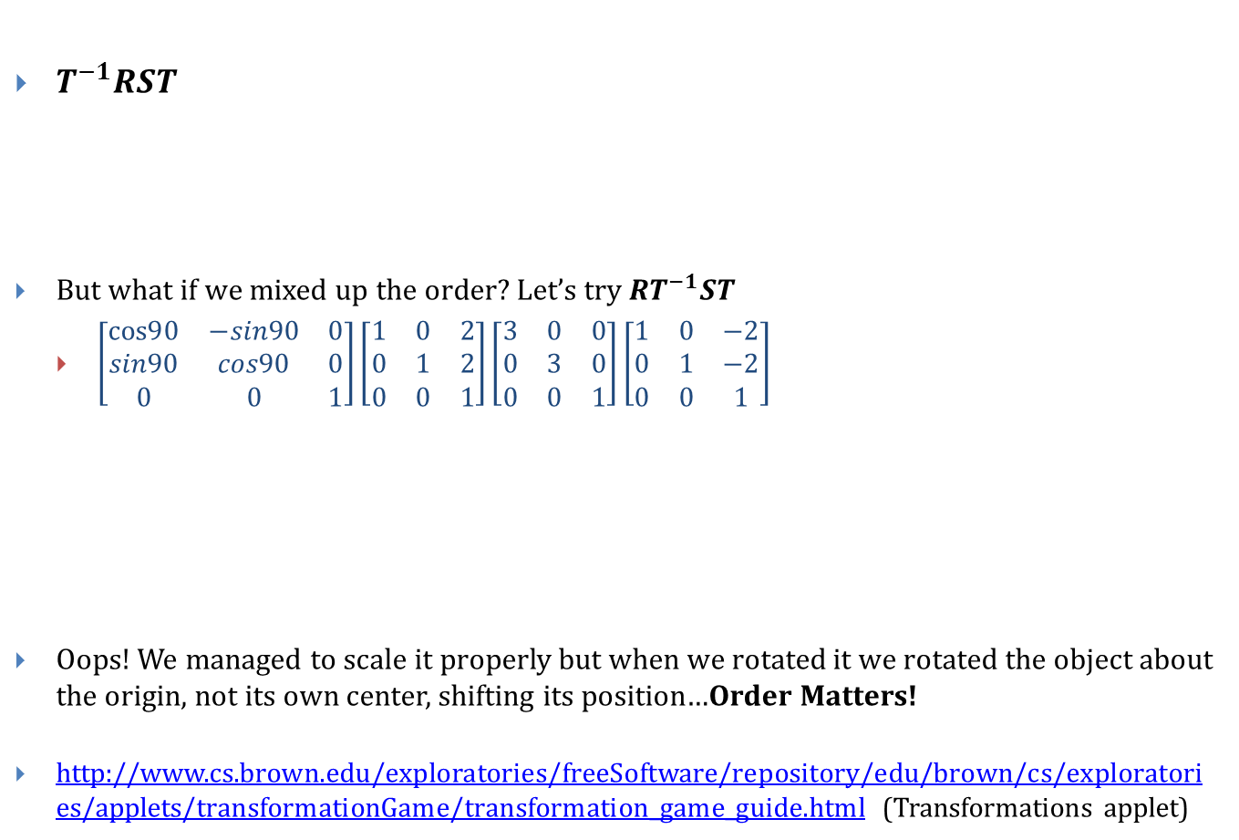

Composition (an example) (2D) (2/2)

Slide 28
Questions?

Slide 29
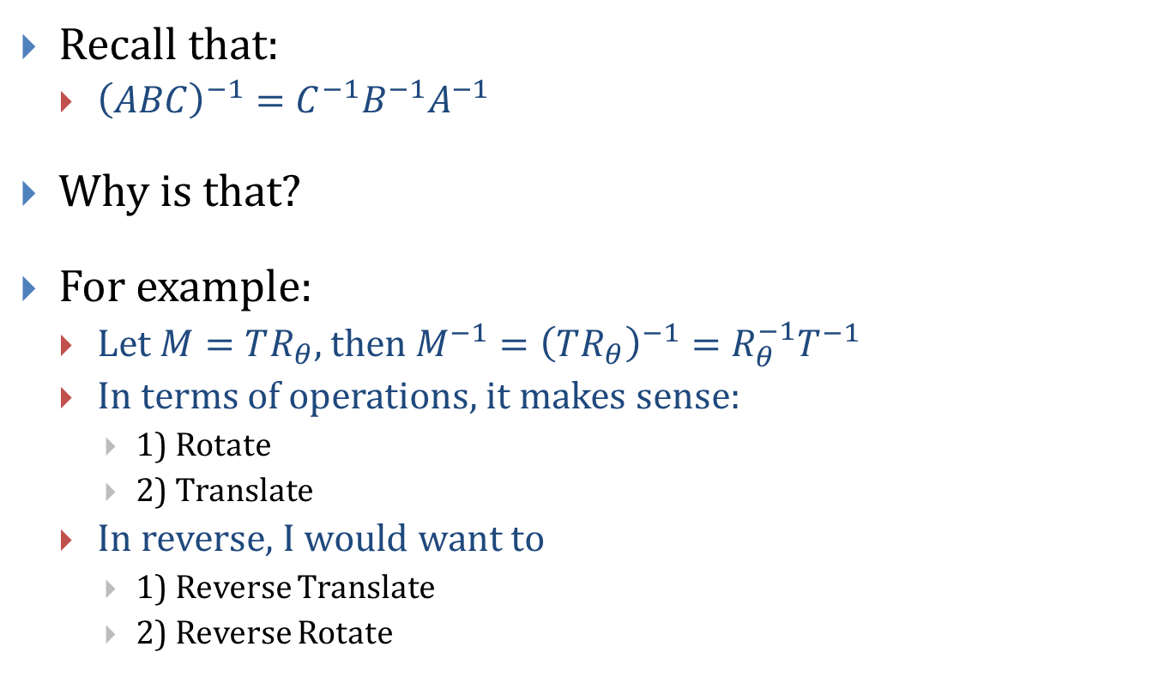
Inverse Composite Matrix

Slide 30
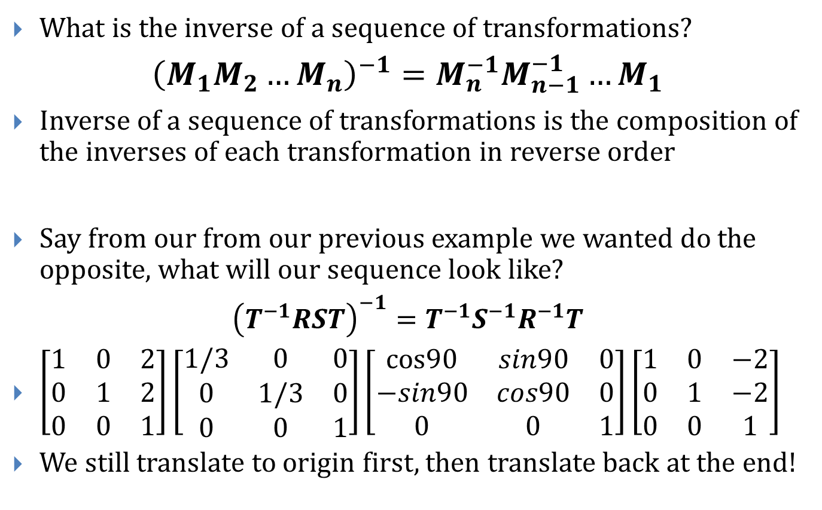
Inverses Revisited

Slide 31
Questions?

Slide 32
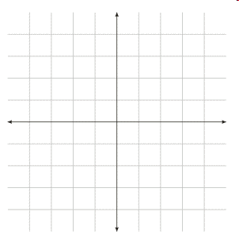
Transforming Coordinate Axes
We understand linear transformations as changing the position of vertices relative to the standard axes
Can also think of transforming the coordinate axes themselves
Just as in matrix composition, be careful of which order you modify your coordinate system
Rotation
Scaling
Translation

Slide 33
Mapping It to 3D
We have been doing everything in 2D. What happens in 3D Cartesian Coordinate System?

Slide 34
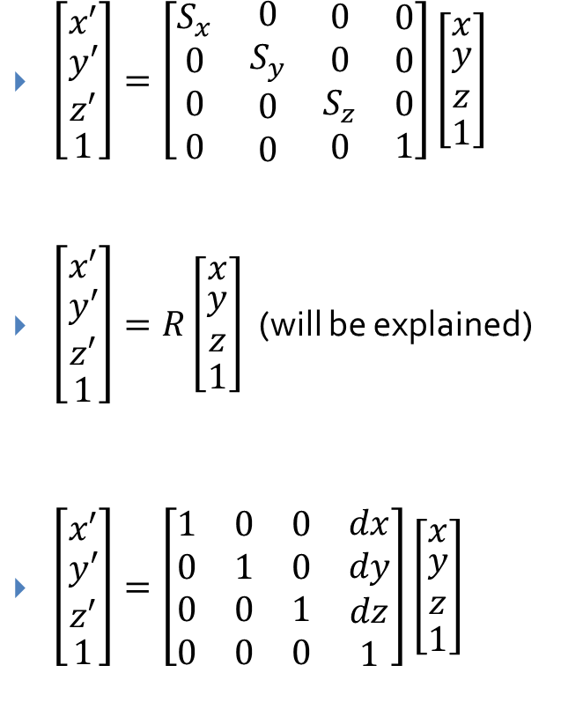
Composition of Transformations!

Slide 35
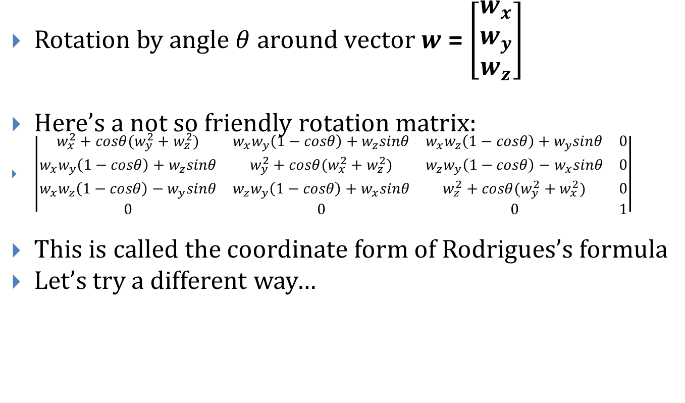
Rotation

Slide 36
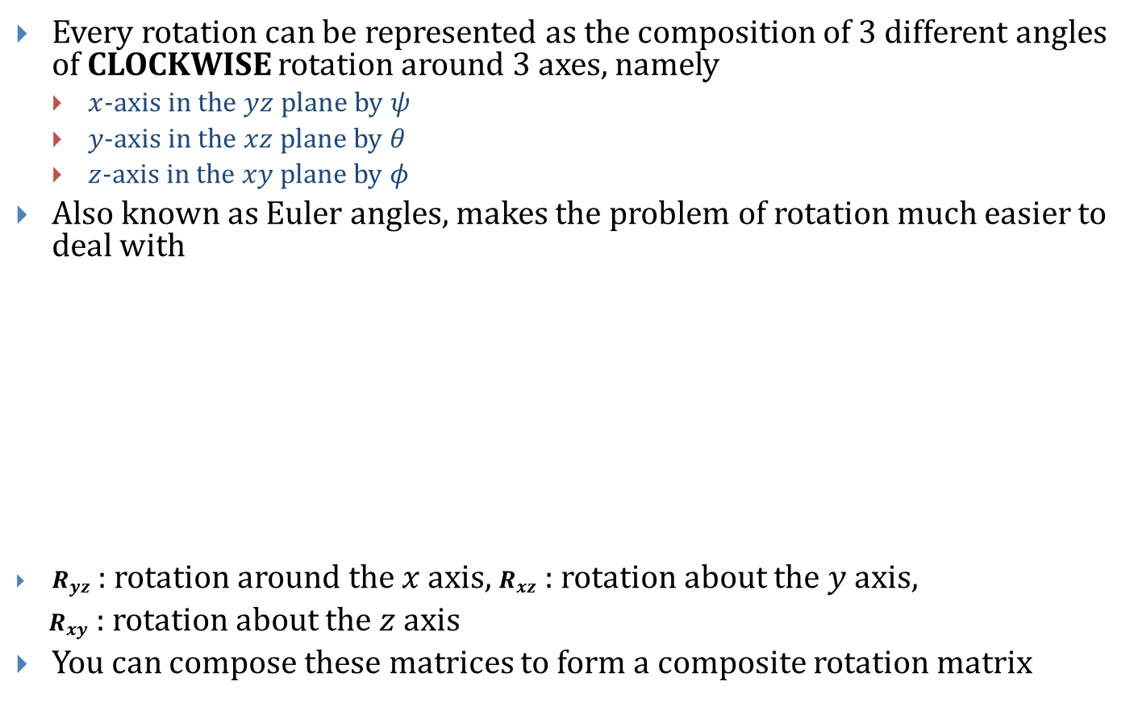
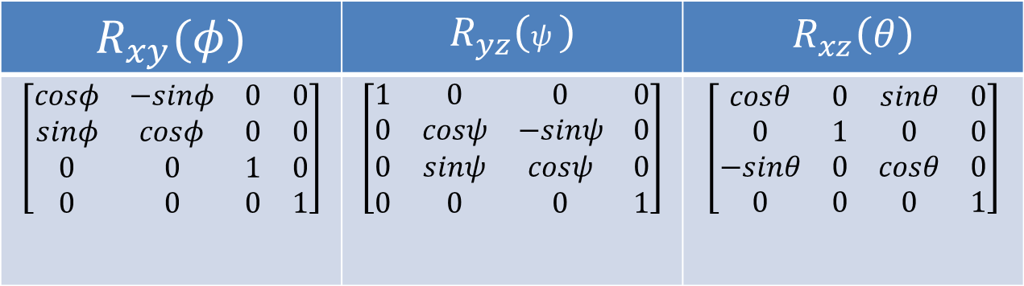
Rotating axis by axis (1/2)
Notes:
italic

Slide 37
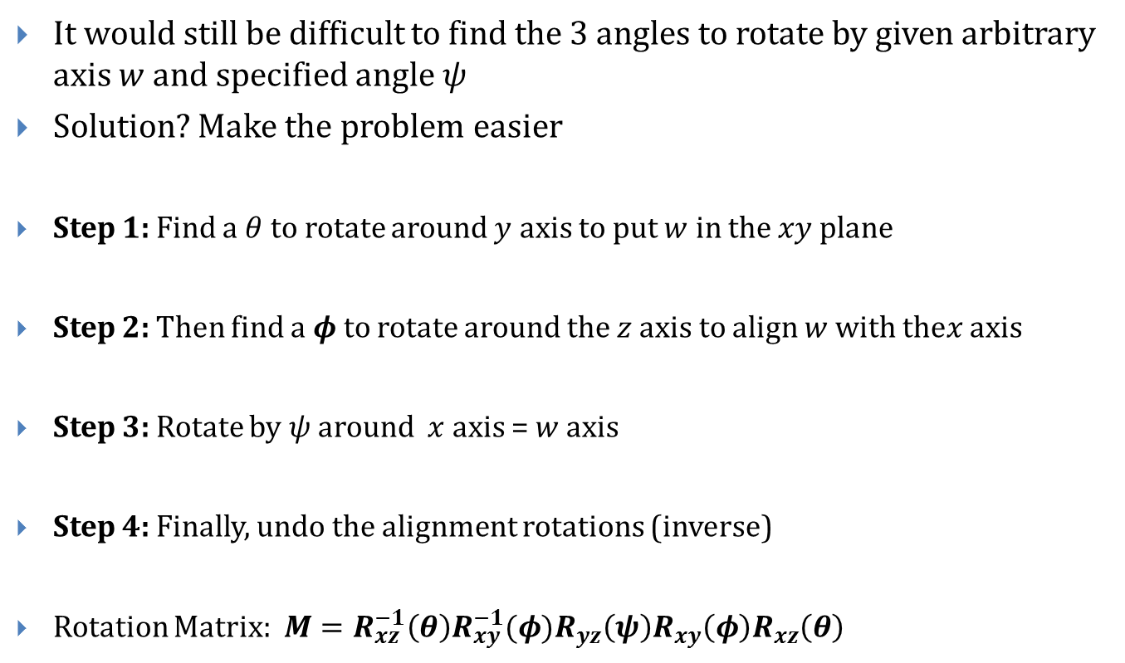
Rotating axis by axis (2/2)

Slide 38
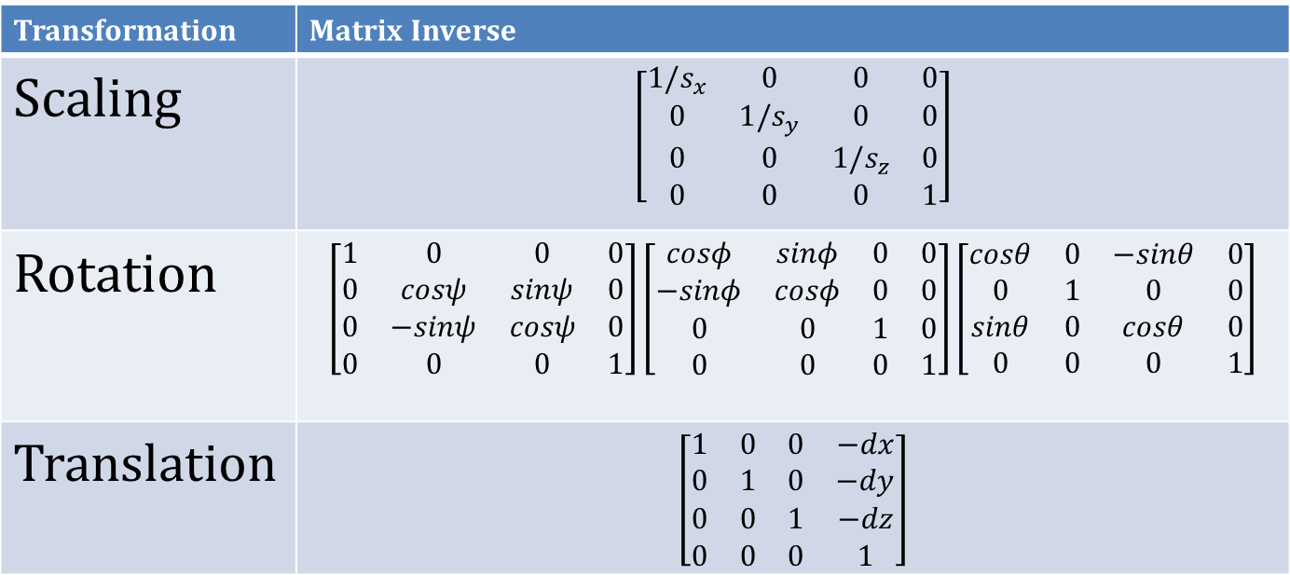
Inverses and Composition in 3D!
Inverses are once again parallel to their 2D versions…
Composition works exactly the same way…
Transformation | Matrix Inverse
Scaling
Rotation
Translation

Slide 39
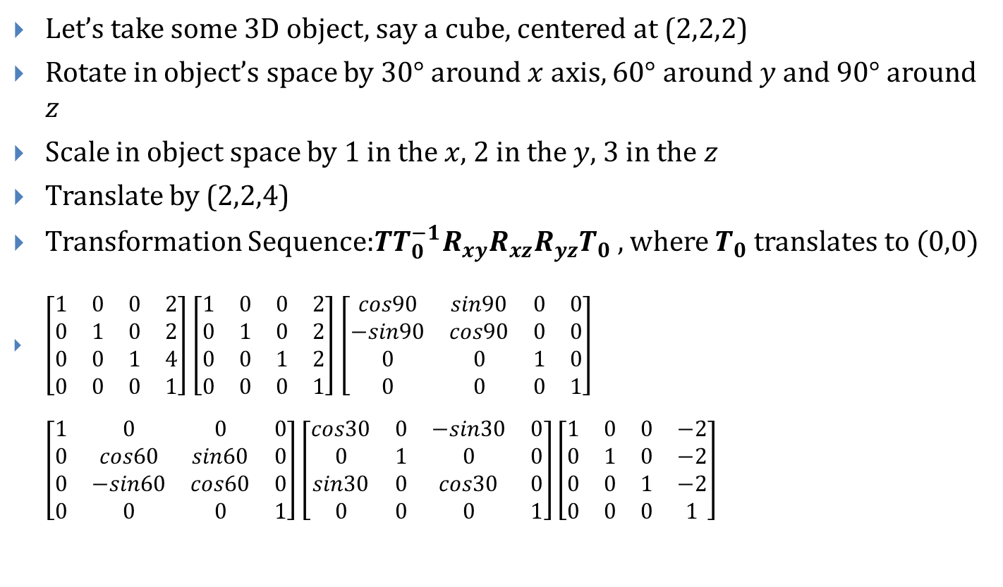
Example in 3D!

Slide 40
Questions?

Slide 41
How to Invert a Matrix
We’re going to use Gauss-Jordan elimination
Finding A⁻¹ with Gauss-Jordan elimination is done by augmenting A with I to get [A|I], then reducing the new matrix into reduced row echelon form (rref) to get a new matrix. This new matrix will be of the form [I|A⁻¹]
What does rref really mean?
If a row does not consist entirely of zeros, then the first nonzero number in the row is a 1. (Call this a leading 1)
If there are any rows that consist entirely of zeros, then they are grouped together at the bottom of the matrix.
If any two successive rows do not consist entirely of zeros, the leading 1 in the lower row occurs farther to the right than the leading 1 in the higher row
Each column that contains a leading 1 has zeros everywhere else.

Slide 42
How to Invert a Matrix
To transform a matrix into rref we are allowed to perform any of the three elementary row operations. These are:
Multiply a row by a nonzero constant
Interchange two rows
Add a multiple of one row to another row

Slide 43
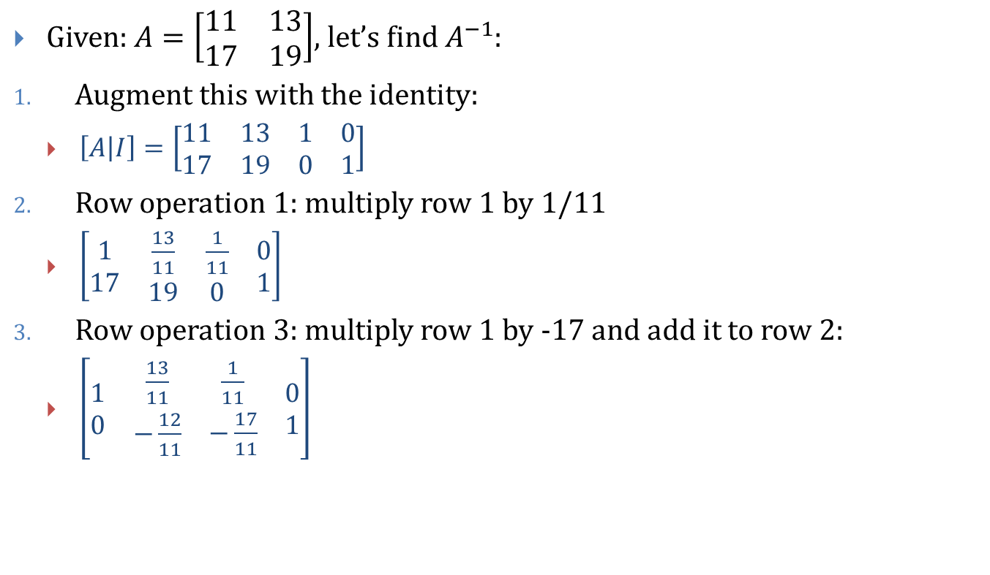
How to Invert a Matrix, Example

Slide 44
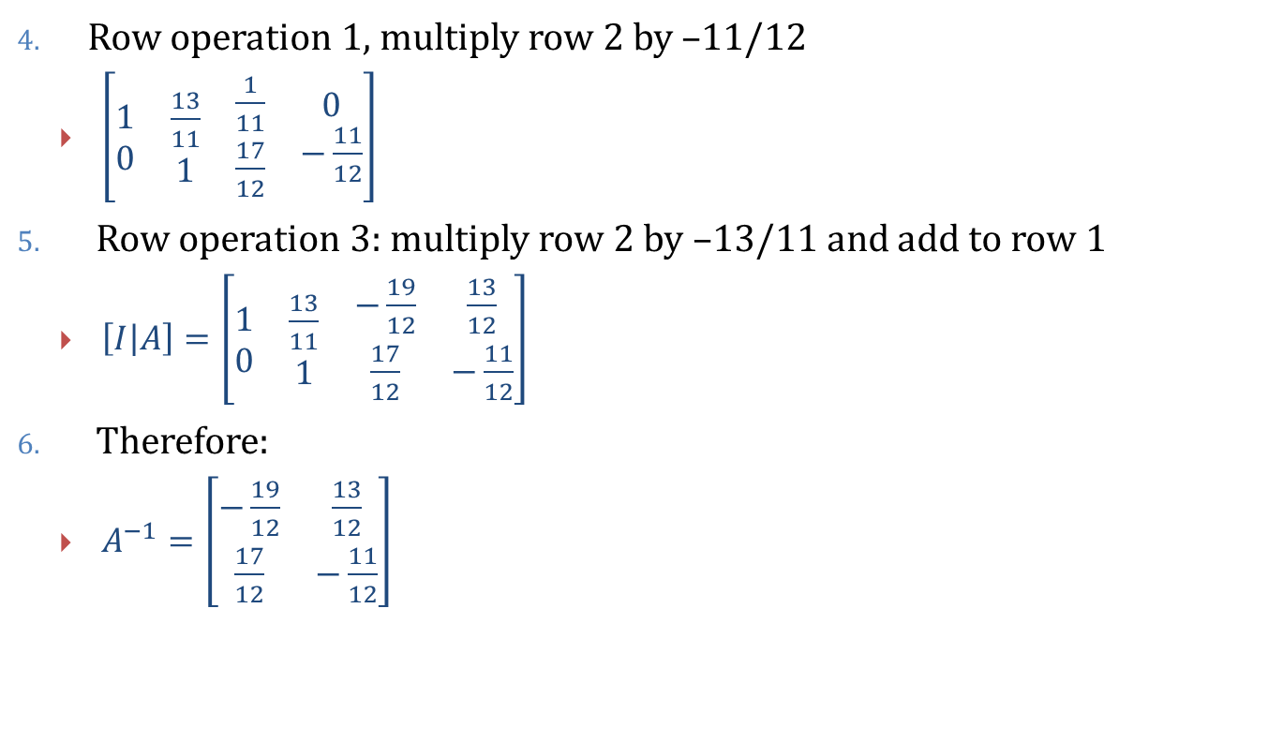
How to Invert a Matrix, Example

Slide 45
Questions?

Slide 46
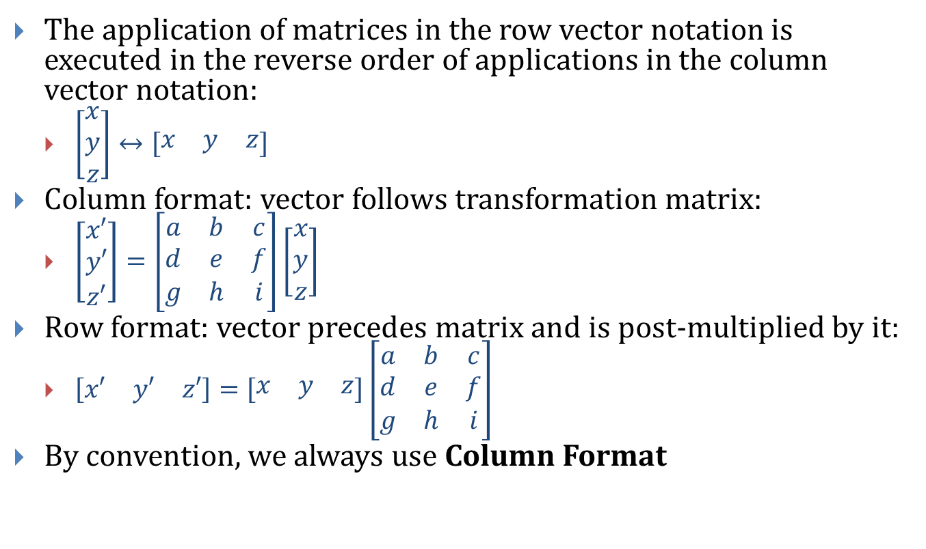
Addendum – Matrix Notation

Slide 47
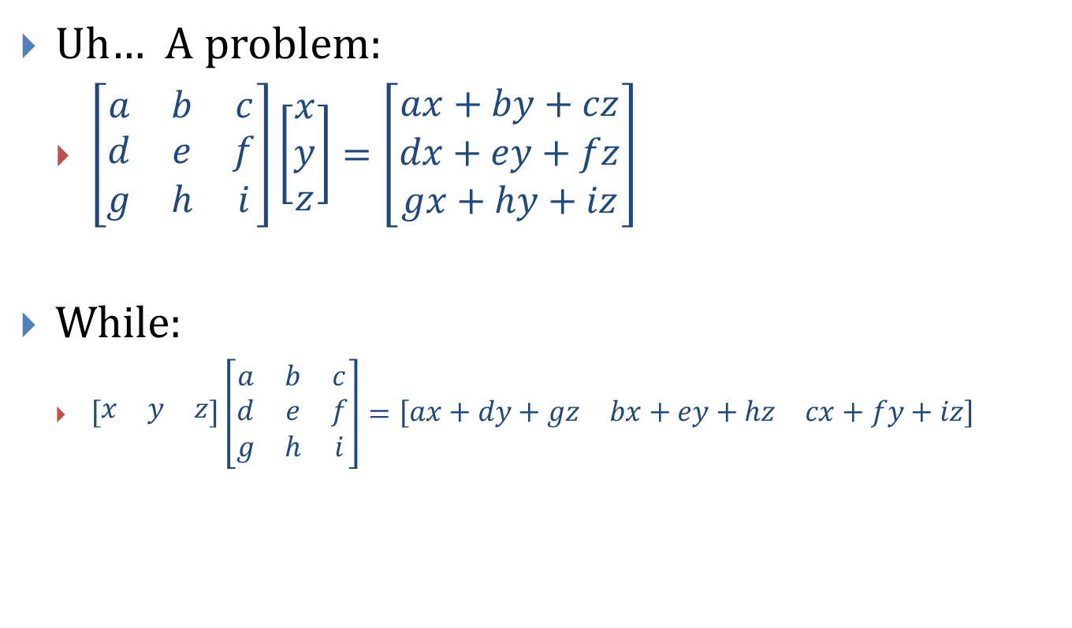
Addendum – Matrix Notation

Slide 48
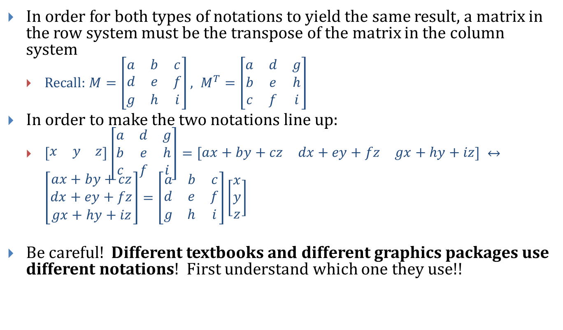
Addendum – Matrix Notation

Slide 49
Questions?

Slide 50
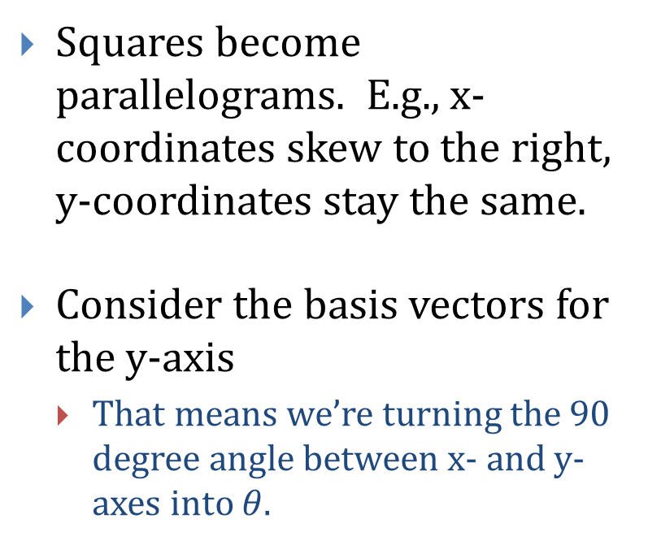
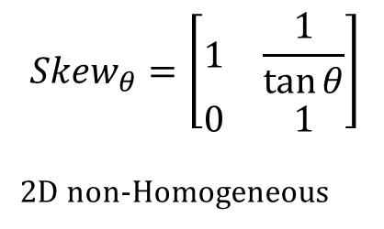
Addendum: Shearing / Skewing
Shearing refers to the “sliding” or “skewing” effect
Y
6
5
4
3
2
1
0
1
2
3
4
5
6
7
8
9
10
X

Slide 51
Questions?

Slide 52
CSE 470/598 Transformations and OpenGL
Ross Maciejewski
rmacieje@asu.edu

Slide 53
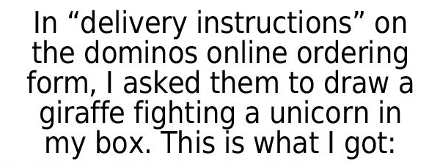
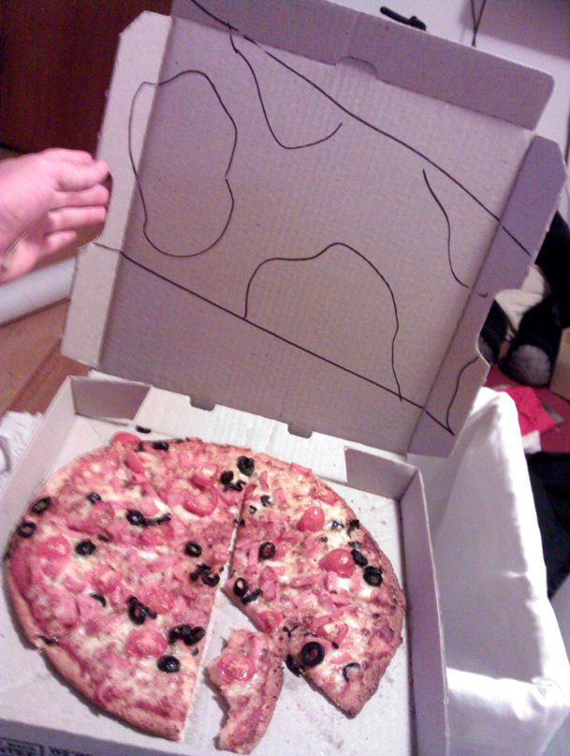
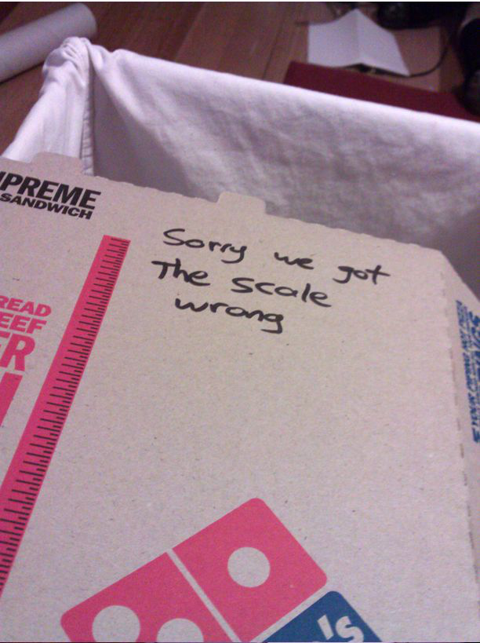

Slide 54
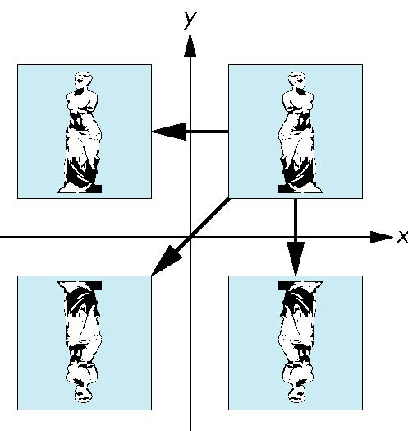
Reflection
corresponds to negative scale factors
s_{x} = -1 s_{y} = 1
original
s_{x} = -1 s_{y} = -1
s_{x} = 1 s_{y} = -1

Slide 55

Rotation About a Fixed Point other than the Origin
Move fixed point to origin
Rotate
Move fixed point back
M = T(p_{f}) R(θ) T(-p_{f})

Slide 56

Instancing
In modeling, we often start with a simple object centered at the origin, oriented with the axis, and at a standard size
We apply an instance transformation to its vertices to
Scale
Orient
Locate

Slide 57
OpenGL Matrices
OpenGL: matrices are part of the state
Multiple types
Model-View (GL_MODELVIEW)
Projection (GL_PROJECTION)
Texture (GL_TEXTURE) (ignore for now)
Color (GL_COLOR) (ignore for now)
Single set of functions for manipulation
Select which to manipulated by
glMatrixMode(GL_MODELVIEW);
glMatrixMode(GL_PROJECTION);

Slide 58
Current Transformation Matrix (CTM)
Conceptually there is a 4 x 4 homogeneous coordinate matrix, the current transformation matrix (CTM) that is part of the state and is applied to all vertices that pass down the pipeline
The CTM is defined in the user program and loaded into a transformation unit
C
p
p’=Cp
vertices
CTM
vertices

Slide 59
CTM operations
The CTM can be altered either by loading a new CTM or by postmutiplication
Load an identity matrix: C ← I
Load an arbitrary matrix: C ← M
Load a translation matrix: C ← T
Load a rotation matrix: C ← R
Load a scaling matrix: C ← S
Postmultiply by an arbitrary matrix: C ← CM
Postmultiply by a translation matrix: C ← CT
Postmultiply by a rotation matrix: C ← C R
Postmultiply by a scaling matrix: C ← C S

Slide 60
Rotation About a Fixed Point
Start with identity matrix: C ← I
Move fixed point to origin: C ← CT
Rotate: C ← CR
Move fixed point back: C ← CT ⁻¹
Result: C = TR T ^{–1} which is backwards.
This result is a consequence of doing postmultiplications.
Let’s try again.

Slide 61
Reversing the Order
We want C = T ^{–1} R T
so we must do the operations in the following order
C ← I
C ← CT ⁻¹
C ← CR
C ← CT
Each operation corresponds to one function call in the program.
Note that the last operation specified is the first executed in the program

Slide 62

CTM in OpenGL
OpenGL has a model-view and a projection matrix in the pipeline which are concatenated together to form the CTM
Can manipulate each by first setting the correct matrix mode

Slide 63
Rotation, Translation, Scaling
Load an identity matrix:
glLoadIdentity()
Multiply on right:
glRotatef(theta, vx, vy, vz)
theta in degrees, (vx, vy, vz) define axis of rotation
glTranslatef(dx, dy, dz)
glScalef(sx, sy, sz)
Each has a float (f) and double (d) format (glScaled)

Slide 64
Example
Rotation about z axis by 30 degrees with a fixed point of (1.0, 2.0, 3.0)
Remember that last matrix specified in the program is the first applied
glMatrixMode(GL_MODELVIEW);
glLoadIdentity();
glTranslatef(1.0, 2.0, 3.0);
glRotatef(30.0, 0.0, 0.0, 1.0);
glTranslatef(-1.0, -2.0, -3.0);

Slide 65
Arbitrary Matrices
Can load and multiply by matrices defined in the application program
The matrix m is a one dimension array of 16 elements which are the components of the desired 4 x 4 matrix stored by columns
In glMultMatrixf, m multiplies the existing matrix on the right
glLoadMatrixf(const Glfloat *m)
glMultMatrixf(const Glfloat *m)

Slide 66
Row vs. Column-major Order
How to lay out a 2D array in memory?
Two options
Rows: a, b, c, d, e, f, g, h, i, j, k, l, m, n, o, p
Columns: a, e, i, m, b, f, j, n, c, g, k, o, d, h, l, p
OpenGL expects column-major
C stores in row-major
float data[4][4] = { { a, b, c, d}, {e, f, g, h}, …};
Need to transpose before sending to OpenGL

Slide 67
Matrix Stacks
In many situations we want to save transformation matrices for use later
Traversing hierarchical data structures (Chapter 10)
Avoiding state changes when executing display lists
OpenGL maintains stacks for each type of matrix
Access present type (as set by glMatrixMode) by
glPushMatrix()
glPopMatrix()

Slide 68
Coordinate Systems
The units in glVertex are determined by the application and are called object or problem coordinates
The viewing specifications are also in object coordinates and it is the size of the viewing volume that determines what will appear in the image
Internally, OpenGL will convert to camera (eye) coordinates and later to screen coordinates
OpenGL also uses some internal representations that usually are not visible to the application

Slide 69
Two- and three-dimensional viewing
In glOrtho(left, right, bottom, top, near, far) the near and far distances are measured from the camera
Two-dimensional vertex commands place all vertices in the plane z=0
If the application is in two dimensions, we can use the function
gluOrtho2D(left, right,bottom,top)
In two dimensions, the view or clipping volume becomes a clipping window

Slide 70
Three-dimensional Applications
In OpenGL, two-dimensional applications are a special case of three-dimensional graphics
Going to 3D
Not much changes
Use glVertex3*( )
Have to worry about the order in which polygons are drawn or use hidden-surface removal
Polygons should be simple, convex, flat

Slide 71

Questions?

